Slide 1
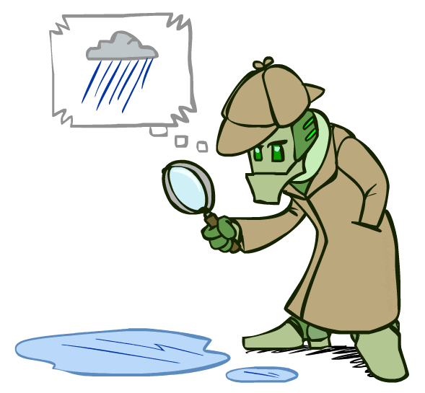
KNN

Slide 2
Definition:
K-Nearest Neighbours is one of the most basic yet essential classification algorithms in Machine Learning. It belongs to the supervised learning domain and finds intense application in pattern recognition, data mining, and intrusion detection.

Slide 3
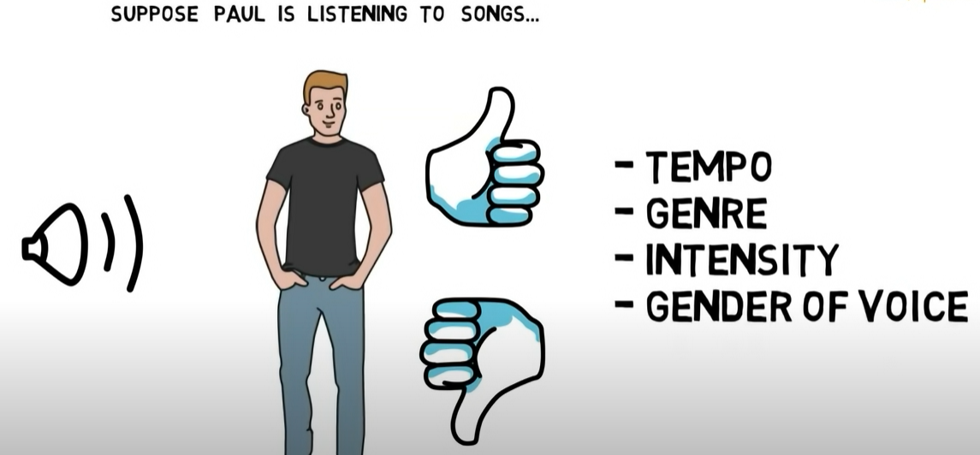
Example:
(Zhon-ruh)

Slide 4
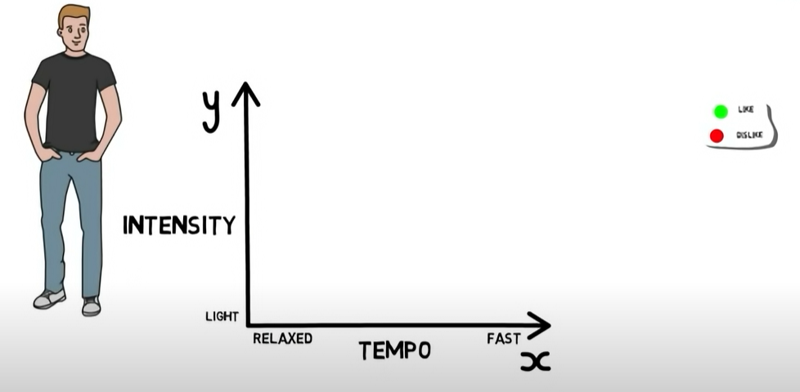

Slide 5
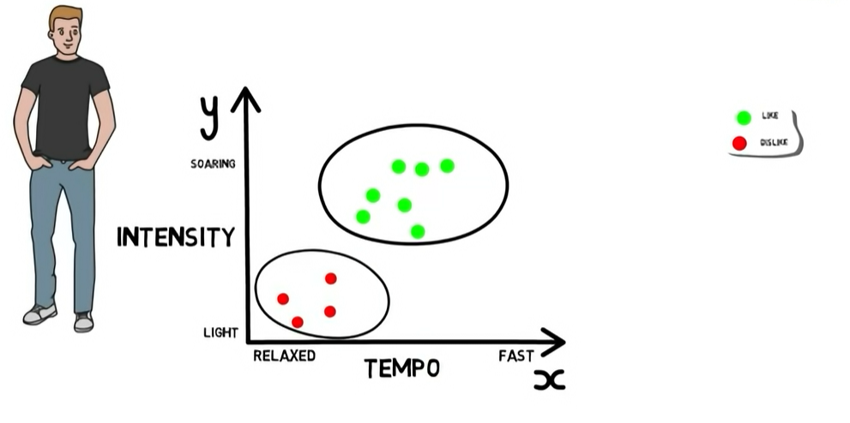

Slide 6
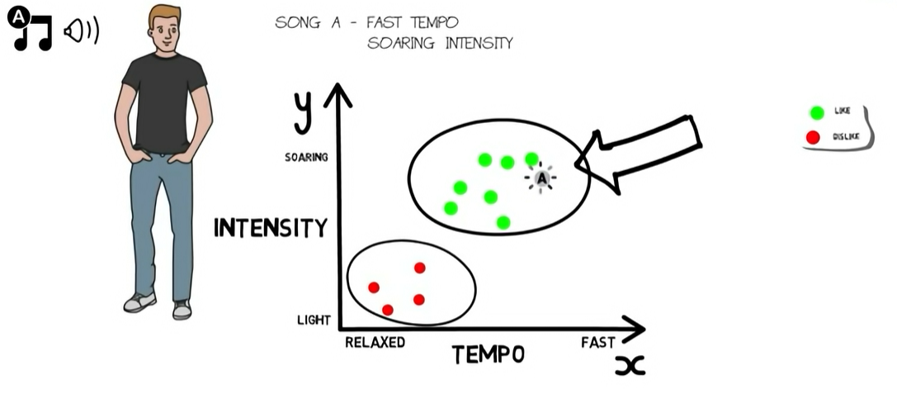

Slide 7
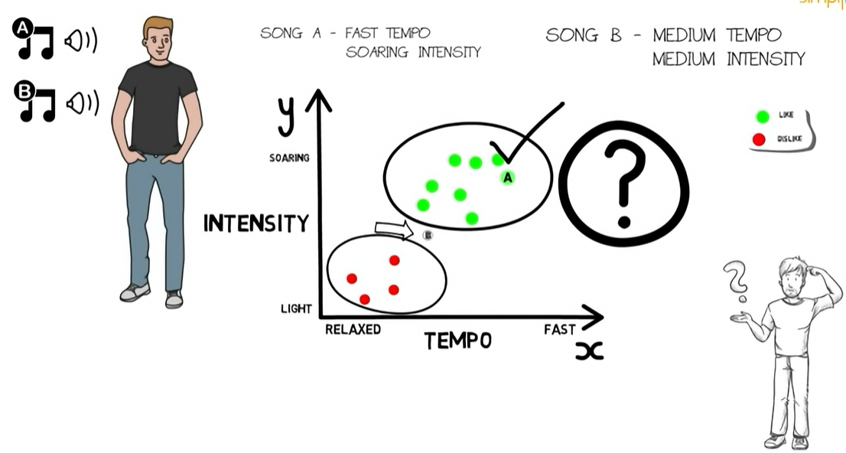

Slide 8
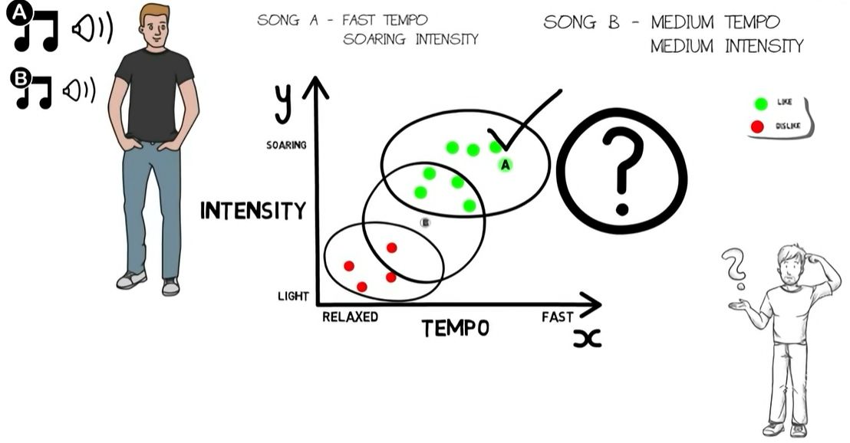


Slide 9
Example
BRIGHTNESS | SATURATION | CLASS
40 | 20 | Red
50 | 50 | Blue
60 | 90 | Blue
10 | 25 | Red
70 | 70 | Blue
60 | 10 | Red
25 | 80 | Blue
BRIGHTNESS | SATURATION | CLASS
20 | 35 | ?

Slide 10
Example
Euclidean distance formula: √(X₂-X₁)²+(Y₂-Y₁)²
X₂ = New entry's brightness (20).
X₁= Existing entry's brightness.
Y₂ = New entry's saturation (35).
Y₁ = Existing entry's saturation.
d1 = √(20 - 40)² + (35 - 20)² = √400 + 225 = √625 = 25

Slide 11
Example
d2 = √(20 - 50)² + (35 - 50)² = √900 + 225 = √1125 = 33.54
BRIGHTNESS | SATURATION | CLASS | DISTANCE
40 | 20 | Red | 25
50 | 50 | Blue | 33.54
60 | 90 | Blue | 68.01
10 | 25 | Red | 10
70 | 70 | Blue | 61.03
60 | 10 | Red | 47.17
25 | 80 | Blue | 45

Slide 12
Example
Let's rearrange the distances in ascending order:
BRIGHTNESS | SATURATION | CLASS | DISTANCE
10 | 25 | Red | 10
40 | 20 | Red | 25
50 | 50 | Blue | 33.54
25 | 80 | Blue | 45
60 | 10 | Red | 47.17
70 | 70 | Blue | 61.03
60 | 90 | Blue | 68.01

Slide 13
Example
Since we chose 5 as the value of K, we'll only consider the first five rows. That is:
So according to this new instance will belong to category Red
BRIGHTNESs | SATURATION | CLASS | DISTANCE
10 | 25 | Red | 14
40 | 20 | Red | 25
50 | 50 | Blue | 33.54
25 | 80 | Blue | 45.2
60 | 10 | Red | 47.17

Slide 14
How to Choose the Value of K in the K-NN Algorithm
There is no particular way of choosing the value K, but here are some common conventions to keep in mind:
Choosing a very low value will most likely lead to inaccurate predictions.
The commonly used value of K is 5.
Always use an odd number as the value of K.

Slide 15
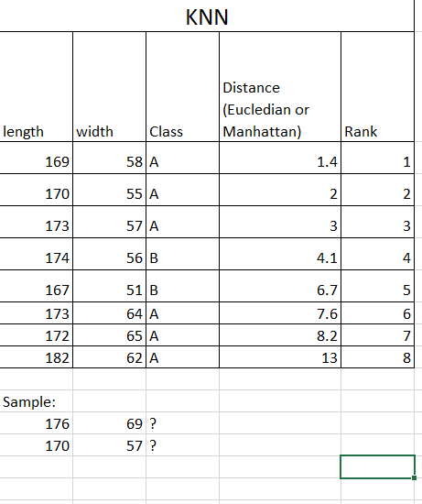
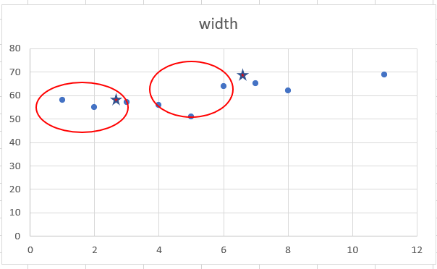
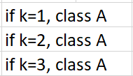

KNN (k- nearest neighbor)

